Slide 1
Avanade DevOps Practitioner
Creating Flow

Slide 2



Expectations During Sessions
Share your experience and ask questions
Participate in the activities
Stay Engaged

Slide 3
Avanade DevOps Practitioner Sessions
Sessions
1 | Pre-work overview
2 | Using Azure DevOps Services, Security in DevOps
3 | Practices to create fast flow
4 | Practices to create fast and continuous feedback
5 | Practices of experimentation and continuous learning
6 | Azure security and compliance
Session Agenda
Azure Pipelines, Azure Releases, IaC, GitHub

Slide 4
Learning Objectives Activity
5 minutes
Refine the learning objectives you added at the start of last week.
Notes:
https://dev.azure.com/ava-continuous-learning/DevOps%20Practitioner%20NA/_queries/query/b52283c4-2f71-4cd3-b90d-47271e1c6ad5/
We are going to take five minutes at the start of this session to reflect on our learning objectives. I would like each you have to take these first five minutes and refine what you have entered at the start of the course. Please note that we have gone through and added tags to your learning objectives to group them. As part of this refinement activity, we would like you to check the title, add a description, and start putting in an acceptance criteria that describes to your best ability what you needs to be covered to satisfy that learning objective.
Also, if you have new objectives please add them, and last if we have covered or actively covering your learning objective, please update the status.

Slide 5
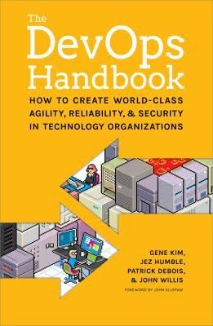
The Practices of Flow
Flow
Feedback
Experimentation
Dev
Dev
Ops
Dev
Ops
Ops
The practices to create Fast Flow from
Development into Operations

Slide 6
Session 3 (2.5 hrs)
Learning objectives
Key elements and overview of practices of flow
Create a build pipeline with Azure Pipelines (with code in Git repo in same team project and in GitHub)
Run quality tests in build pipeline (unit test, static code analysis, sonar cube, GH security scanning)
Manage build dependencies with Azure Artifacts
Use your own build agent when Microsoft-hosted agents don't meet your needs
Create a release pipeline in Azure Pipelines
Run functional tests in Azure Pipelines
Run nonfunctional tests in Azure Pipelines
Build/Configure Infrastructure in Azure Pipeline
Infrastructure as Code at Avanade
Build CI workflows as GitHub Actions
Notes:
References:
https://docs.microsoft.com/en-us/learn/modules/create-a-build-pipeline

Slide 7
Create a build pipeline with Azure Pipelines
Set up a continuous integration (CI) pipeline that automates the process of building your application.
Learning objectives
Create build pipeline in Azure Pipelines
With code in Git repo in same team project
With code in GitHub repo
Map the manual build steps to automated build tasks
Publish your builds so others can access them
Use templates to build multiple configurations (e.g., debug, release)
Notes:
References:
https://docs.microsoft.com/en-us/learn/modules/create-a-build-pipeline

Slide 8
Key elements of Practices of Flow
Creating the foundations of a deployment pipeline
Enable and practice continuous delivery
Architect for low-risk releases
Enable fast and reliable automated testing
Automate and Enable low-risk releases
Notes:
Continuous Integration and Feature Branching | Dave Farley’s Weblog

Slide 9
What is a deployment pipeline?
Creating Foundations of Deployment Pipeline
a deployment pipeline is an automated manifestation of your process for getting software from version control into the hands of your users
Automated acceptance test stage(s)
Release stage
Developer /
Pre-Commit
Version Control
Build and Unit Testing
Automated Acceptance Testing
User Acceptance Testing
Release
(Production)
Commit stage
Manual test stage(s)

Slide 10
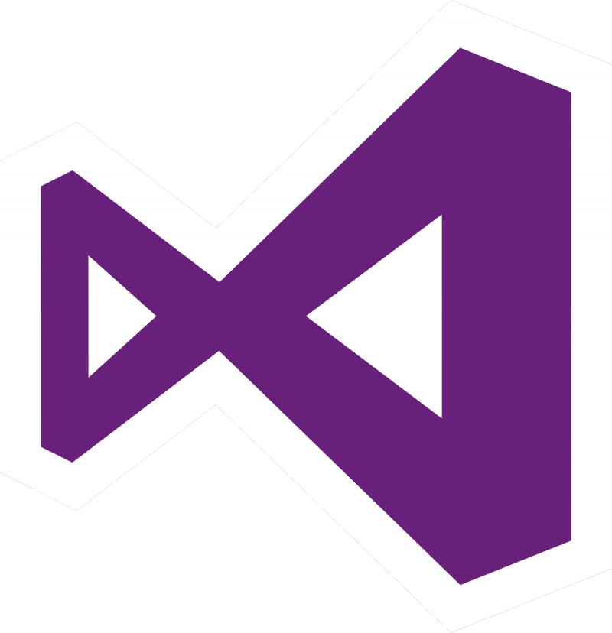
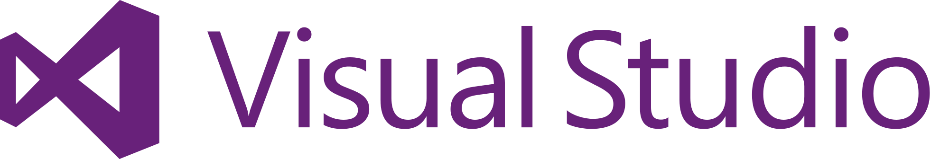


Version control tooling
Creating Foundations of Deployment Pipeline
Git (distributed) and TFVC – Team Foundation Version Control (centralized)
Azure Repos supports both link
All version-controlled artefacts are directly linked to PBIs, bugs, or Tasks continuously driving the work
Supports any IDE and any code
Tightly integrated with the Build & Release functionality
At Avanade, we use Git unless there is a compelling reason not to. E.g., client is not ready

Slide 11
Flow concepts overview
DevOps - Flow guidance, in the Avanade Delivery Framework, illustrates key elements of the principle of flow. Link
Continuous Integration (CI) is the practice of merging all developer working copies into a shared mainline several times a day.
You may have observed that Continuous Delivery and Continuous Deployment are often used interchangeably. That might cause confusion. Please refer to this guidance from ADF to understand Avanade's standpoint on these, and to clarify these terms up-front, with both the client and the Avanade solutioning team, by removing any assumptions.
Continuous Delivery is a software engineering approach in which teams produce software in short cycles, ensuring that the software can be reliably released at any time, i.e., it's ready to be released to production even if it's not actually continuously put into production.
Continuous Deployment (CD) means that every change is automatically deployed to production. With Azure DevOps, you can automate deployments to on-premise, hybrid, or cloud, (Azure, AWS, Google, etc.), environments.

Slide 12
Continuous Integration – Typical flow
Automate and Enable Low-Risk Releases
Developer /
Pre-Commit
Version Control /
Pull Request
Build and Unit Testing
Automated Acceptance Testing
User (manual) Acceptance Testing
Release
(Production)
Push/ Check-in
1
2
Trigger
Feedback
3
Feedback
4

Slide 13
Continuous Delivery – Typical flow
Automate and Enable Low-Risk Releases
Developer /
Pre-Commit
Version Control /
Pull Request
Build and Unit Testing
Automated Acceptance Testing
User (manual) Acceptance Testing
Release
(Production)
Push/ Check-in
1
2
Trigger
Feedback
3
Feedback
4
Trigger
5
Feedback
Approval
6
7

Slide 14
Continuous Deployment – Typical flow
Automate and Enable Low-Risk Releases
Developer /
Pre-Commit
Version Control /
Pull Request
Build and Unit Testing
Automated Acceptance Testing
User (manual) Acceptance Testing
Release
(Production)
Push/ Check-in
Trigger
Feedback
Feedback
Trigger
Feedback
Approval
Approval
Notes:
Manual Acceptance testing may be required for items that are not yet automated. These become bottlenecks to continuous deployment.

Slide 15

Demo
We are going to leverage the SH360 Showcase to show off these patterns.
Notes:
If you don’t have your SH360 setup yet, please follow along.
Find the work item we want to work on:
Product Backlog Item 1684: As a reservation manager, I must change the Kid and Adult age by one year - Boards (azure.com)
feature/{number}-change-guest-age-description
File Location:
src/sh360.publicweb/web/SmartHotel360.PublicWeb/Views/Home/Index.cshtml

Slide 16
Avanade DevOps Practitioner
Continuation of Creating Flow

Slide 17
Learning Objectives Activity
8 minutes
Update status on learning objectives and follow up with associated questions.
Notes:
https://dev.azure.com/ava-continuous-learning/DevOps%20Practitioner%20NA/_queries/query/b52283c4-2f71-4cd3-b90d-47271e1c6ad5/
Demonstrate State Change
Adding supporting questions

Slide 18
Learning Objectives Activity
8 minutes
Update status on learning objectives and follow up with associated questions.
Notes:
https://dev.azure.com/ava-continuous-learning/DevOps%20Practitioner%20NA/_queries/query/b52283c4-2f71-4cd3-b90d-47271e1c6ad5/
Demonstrate State Change
Adding supporting questions
We are going to take five minutes at the start of this session to reflect on our learning objectives. I would like each you have to take these first five minutes and refine what you have entered at the start of the course. Please note that we have gone through and added tags to your learning objectives to group them. As part of this refinement activity, we would like you to check the title, add a description, and start putting in an acceptance criteria that describes to your best ability what you needs to be covered to satisfy that learning objective.
Also, if you have new objectives please add them, and last if we have covered or actively covering your learning objective, please update the status.

Slide 19
Simpler Way to Create Service Principle
Quick demo of easier way to create a service principle.
az ad sp create-for-rbac --name "azuredevops-sp-quickdemo" --sdk-auth --role contributor --scopes /subscriptions/{sub-id}
Notes:
az ad sp create-for-rbac --name "azuredevops-sp-quickdemo" --sdk-auth --role contributor --scopes /subscriptions/{47dd0713-55df-415d-8b71-33235027e415}

Slide 20
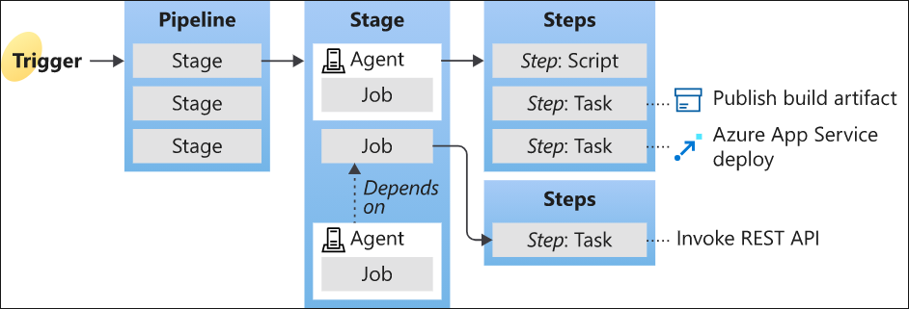
Azure Pipelines - What is Azure Pipelines?
Enables deployment pipeline with Continuous Integration and Continuous Delivery (CI/CD) for the app and platform.
A service that you can use to automatically build, test, and deploy your code project. link
Key concepts link

Slide 21
Azure Pipelines - Key concepts
A trigger tells a Pipeline to run.
A pipeline is made up of one or more stages. A pipeline can deploy to one or more environments.
A stage is a way of organizing jobs in a pipeline and each stage can have one or more jobs.
Each job runs on one agent. A job can also be agentless.
Each agent runs a job that contains one or more steps.
A step can be a task or script and is the smallest building block of a pipeline.
A task is a pre-packaged script that performs an action, such as invoking a REST API or publishing a build artifact.
An artifact is a collection of files or packages published by a run.

Slide 22
Azure Pipelines - Implement and manage build infrastructure
Build agent - computing infrastructure with installed agent software that runs one job at a time
Hosted vs private agents
Agent pools
Concurrent pipelines
Microsoft-hosted parallel jobs, self-hosted parallel jobs
Determine how many parallel jobs you need
At Avanade, we leverage Visual Studio Subscription benefit for any additional parallel pipeline
Notes:
Instructor note – do not spend much time on this slide. Following slides speak to the points. DO call out how we do it “at Avanade”

Slide 23
Azure Pipelines - Implement and manage build infrastructure - Build agents
Build agent
Computing infrastructure with installed agent software that runs one job at a time
In a pipeline
We can use either a Microsoft-hosted agent or a self-hosted (aka private) agent.
Microsoft-hosted agents
Maintenance and upgrades are taken care of for you
Each time you run a pipeline, you get a fresh virtual machine. The virtual machine is discarded after one use.
Self-hosted agents
Agents that you set up and manage to run build and deployment jobs
Give you more control and let you install any software you need for your builds and deployments. You can install the agent on Linux, macOS, or Windows machines. You can also install an agent on a Linux Docker container.
After you've installed the agent on a machine, you can install any other software on that machine as required by your build or deployment jobs.

Slide 24
Azure Pipelines - Implement and manage build infrastructure - Agent pools
Instead of managing each agent individually, you can organize agents into agent pools. Link
An agent pool defines the sharing boundary for all agents in that pool.
Agent pools in an Azure DevOps organization can be shared across projects. Each “project scoped” agent pool can use one “organization scoped” agent pool.
Notes:
Reference:
https://docs.microsoft.com/en-ca/azure/devops/pipelines/agents/agents?view=azure-devops&tabs=browser

Slide 25
Azure Pipelines - Implement and manage build infrastructure – Concurrent pipelines (parallel jobs)
You can run concurrent pipelines (also called parallel jobs).
Whether you run the job on Microsoft-hosted or self-hosted agents, one job in Azure Pipeline lets you run a single build or release at any given time.
Parallel jobs are purchased at the organization level, and they are shared by all projects in an organization
Microsoft-hosted parallel jobs
To run your builds and releases on machines that Microsoft manages
Self-hosted parallel jobs
If you want Azure Pipelines to orchestrate your builds and releases, but use your own machines to run them

Slide 26
Azure Pipelines Parallel jobs
Microsoft-hosted parallel jobs
Your jobs run on the pool of hosted agents
Microsoft provides a free tier of service by default for every organization
Self-hosted parallel jobs
If you want Azure Pipelines to orchestrate your builds and releases, but use your own machines to run them
You can register any number of self-hosted agents in your organization. Microsoft charges based on the number of jobs you want to run at a time, not the number of agents registered.
Configure and pay for parallel jobs link
At Avanade, we leverage Visual Studio Enterprise subscription when available to get one self-hosted parallel job as a subscriber benefit.
Microsoft-hosted vs self-hosted parallel jobs

Slide 27
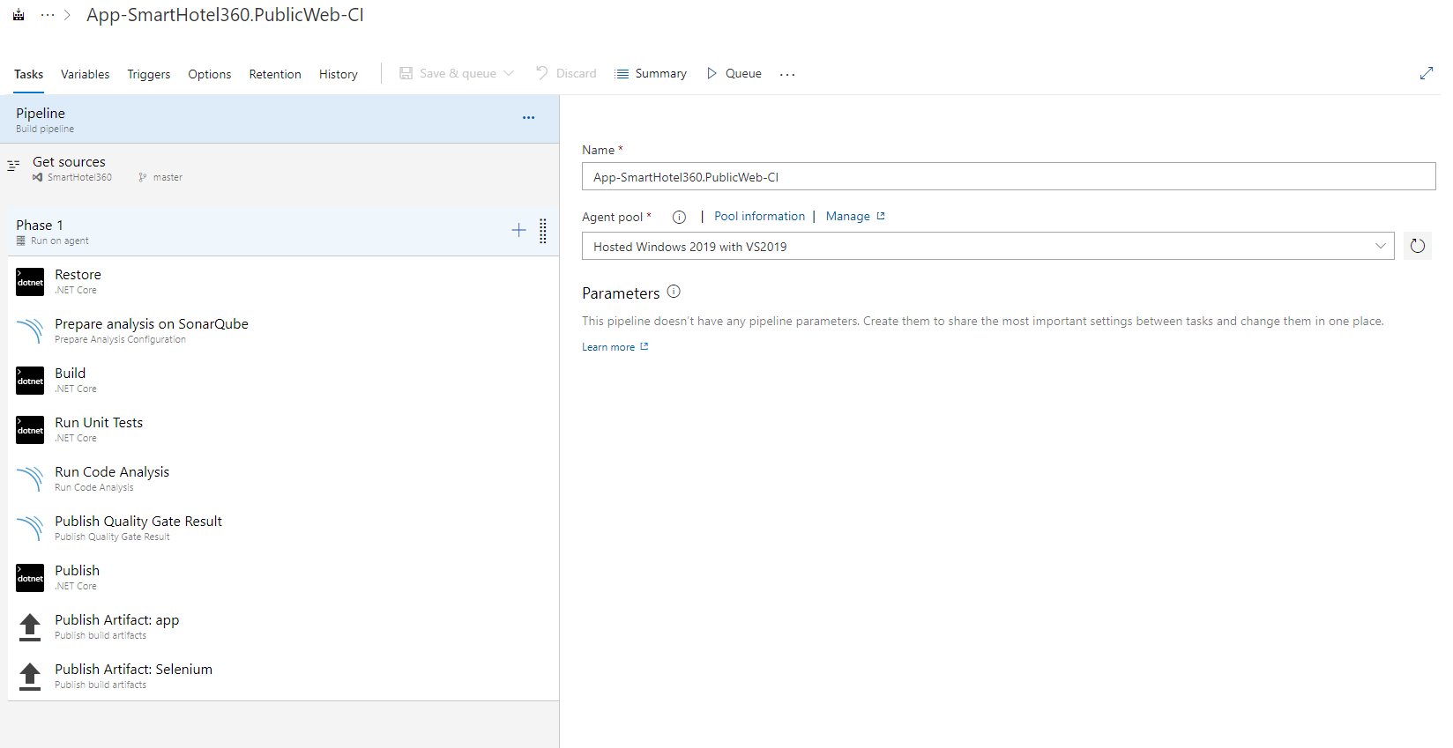
Azure Pipelines Demo
Demo
Open SmartHotel360 in Visual Studio.
Open Azure Pipeline App-SmartHotel360.PublicWeb-CI
See Build pipeline --> Agent pool
Tasks
Triggers
Notes:
References: https://docs.microsoft.com/en-us/learn/modules/run-quality-tests-build-pipeline/

Slide 28
Hand-Over to Adam
We will review the how our teams will start using GitHub Enterprise.

Slide 29
GitHub Enterprise @ Avanade
Avanade's GitHub Enterprise EMU account
https://github.com/enterprises/avanade-internal/
GitHub Enterprise channel in Modern Engineering MS Teams link
Rollout Q4 2021
Security review completed
Remediation tasks that are being worked through
Avanade’s public facing GitHub account
https://github.com/avanade
Notes:
githubpartners/avanade-BCIB-beta: Repository for collaborating on the beta Bootcamp in a Box with Avanade

Slide 30
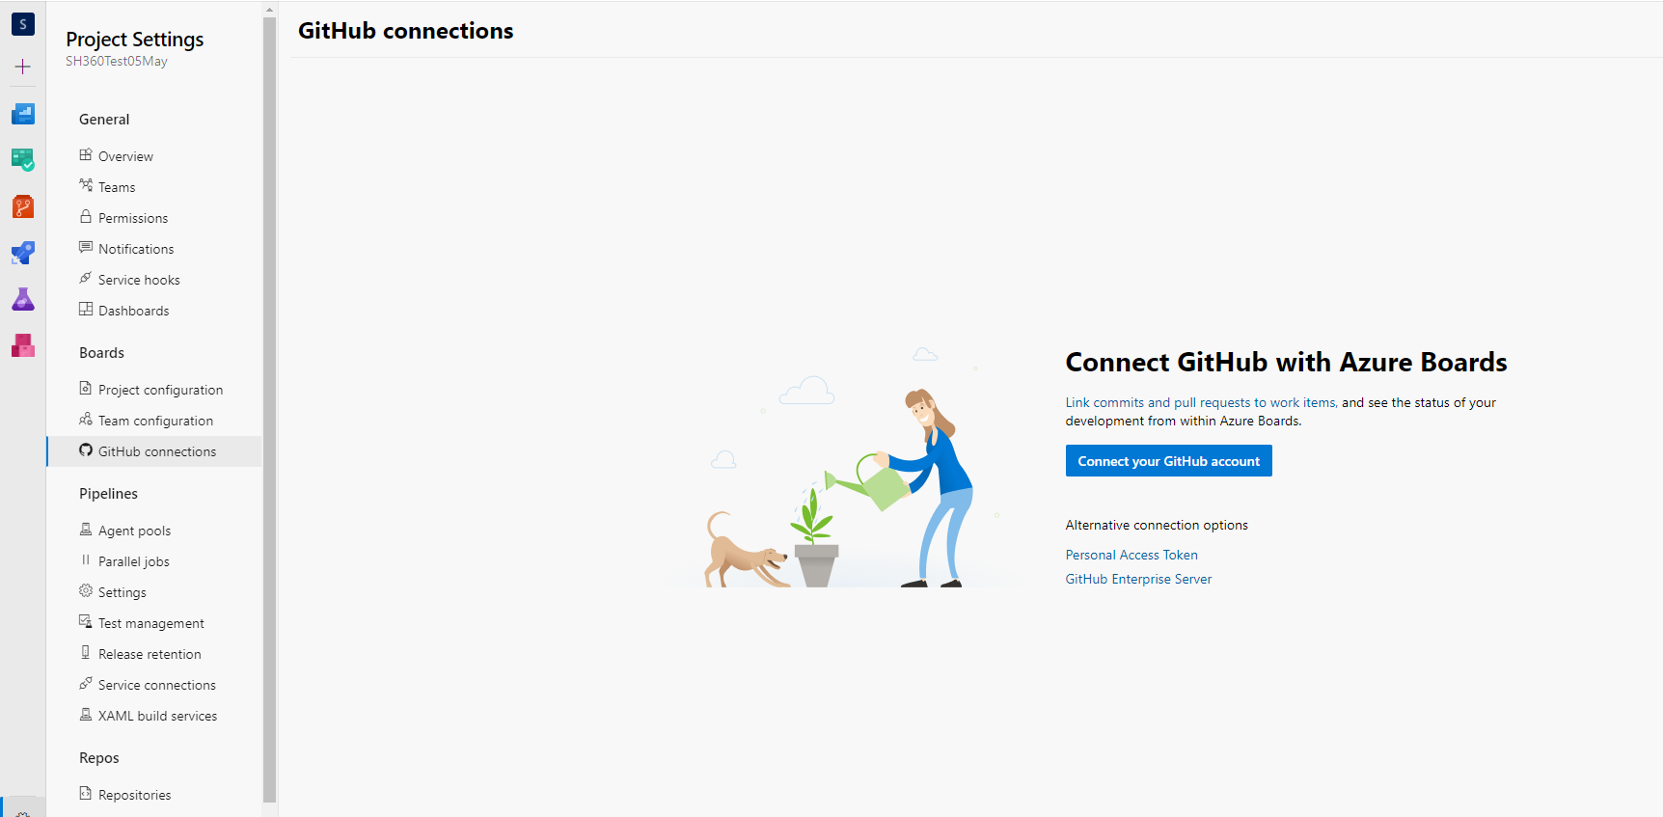
Azure Pipelines - Getting code from GitHub Repo
Azure DevOps Project Settings → GitHub connections
Notes:
k-lemon_avanade/SmartHotel360 (github.com)

Slide 31
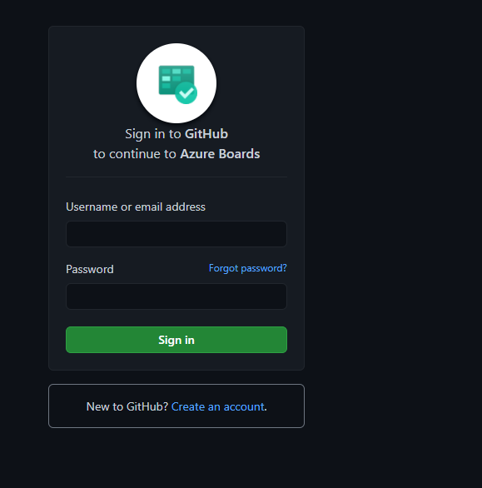
Azure Pipelines - Getting code from GitHub Repo
Azure DevOps Project Settings → GitHub connections
Connect your GitHub account
Sign in to GitHub

Slide 32
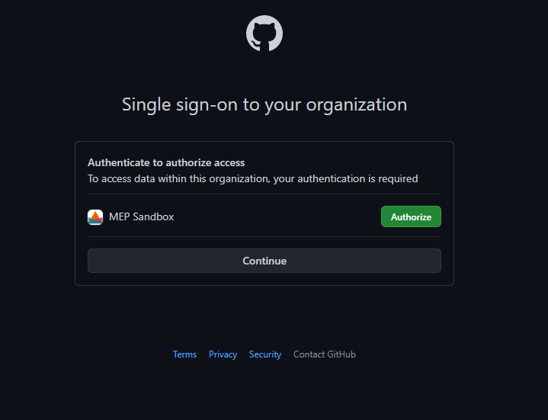
Azure Pipelines - Getting code from GitHub Repo
Azure DevOps Project Settings → GitHub connections
Connect your GitHub account
Sign in to GitHub
Single sign-on to your organization.
Click Authorize (your account needs to be enabled for GitHub Enterprise prior to this step)

Slide 33
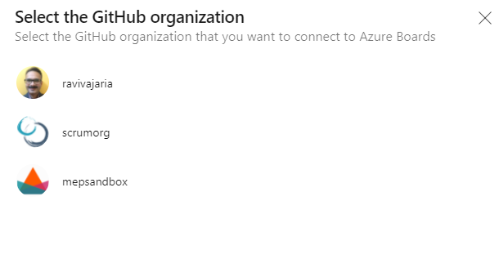
Azure Pipelines - Getting code from GitHub Repo
Azure DevOps Project Settings → GitHub connections
Connect your GitHub account
Sign in to GitHub
Single sign-on to your organization.
Click Authorize (your account needs to be enabled for GitHub Enterprise prior to this step)
Select GitHub Organization

Slide 34
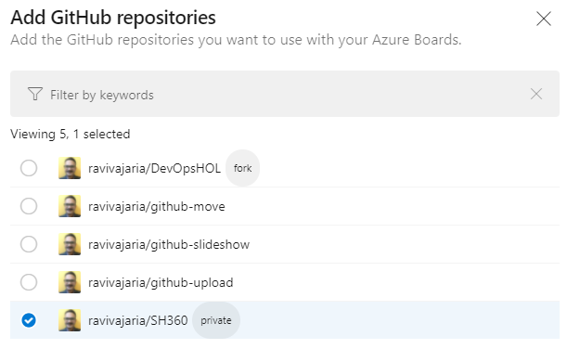
Azure Pipelines - Getting code from GitHub Repo
Azure DevOps Project Settings → GitHub connections
Connect your GitHub account
Sign in to GitHub
Single sign-on to your organization.
Click Authorize (your account needs to be enabled for GitHub Enterprise prior to this step)
Select GitHub Organization
Add GitHub repositories, Save

Slide 35
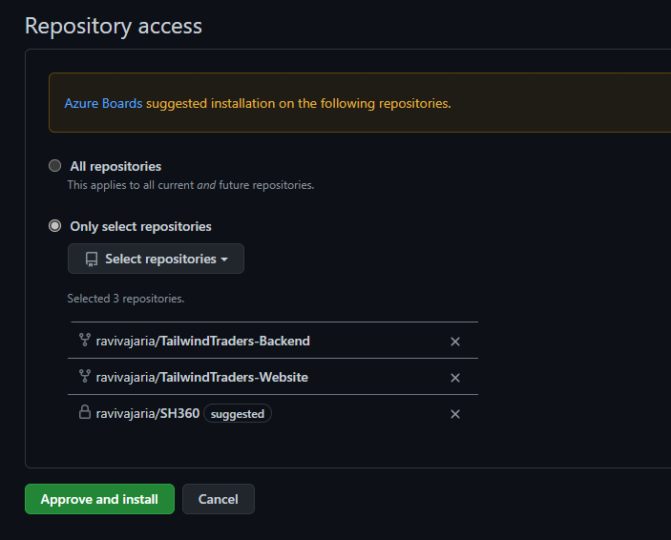
Azure Pipelines - Getting code from GitHub Repo
Azure DevOps Project Settings → GitHub connections
Connect your GitHub account
Sign in to GitHub
Single sign-on to your organization.
Click Authorize (your account needs to be enabled for GitHub Enterprise prior to this step)
Select GitHub Organization
Add GitHub repositories, Save
Approve, Install & Authorize

Slide 36
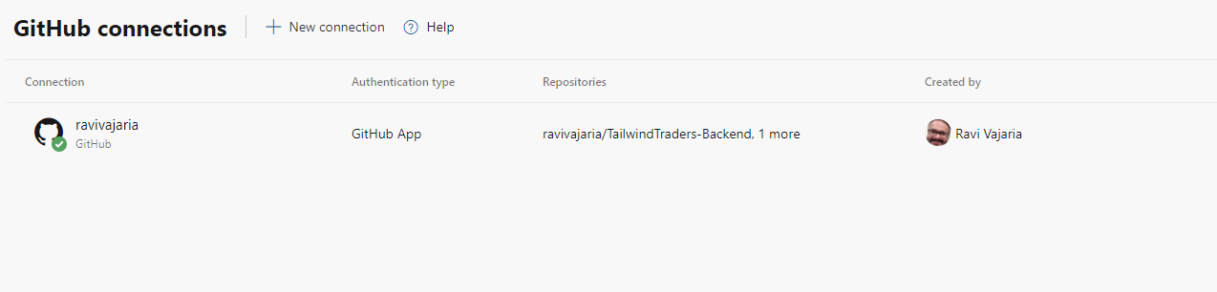
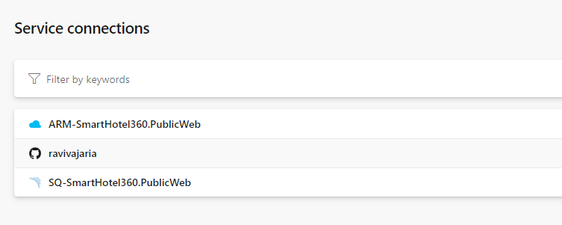
Azure Pipelines - Getting code from GitHub Repo
Azure DevOps Project Settings → GitHub connections
Connect your GitHub account
Sign in to GitHub
Single sign-on to your organization.
Click Authorize (your account needs to be enabled for Avanade GitHub prior to this step for single sign on)
Select GitHub Organization
Add GitHub repositories, Save
Approve, Install & Authorize
See (and manage) connection
- This creates a new service connection

Slide 37
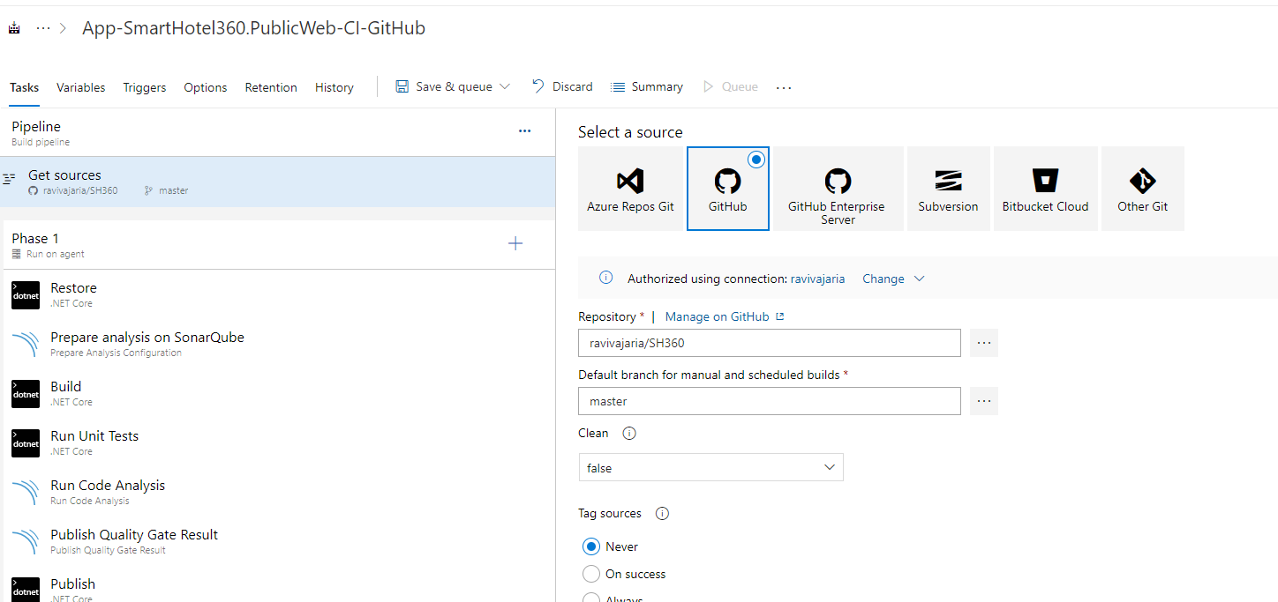
Azure Pipelines - Getting code from GitHub Repo
Select source from GitHub in Azure Pipeline

Slide 38
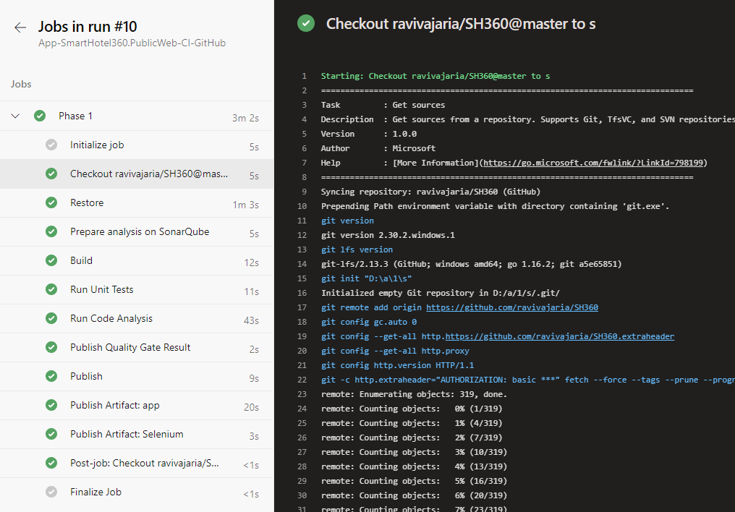
Azure Pipelines - Getting code from GitHub Repo
Save and queue the build.

Slide 39
Run quality tests in build pipeline (GH security scanning)
TO DO

Slide 40
Releases in Azure Pipelines (Principles and Practices of CD)
8 Principles of CD
The process for releasing/deploying software MUST be repeatable and reliable
Automate everything!
If somethings painful, do it more often
Keep everything in source control
Done means “released”
Build quality in
Everybody has responsibility for the release process.
Improve continuously
4 Practices of CD
Build binaries only once
Use precisely the same mechanism to deploy to every environment
Smoke test your deployment
If anything fails, stop the line!

Slide 41
Azure Pipelines - Key concepts (re-visited)
A trigger tells a Pipeline to run.
A pipeline is made up of one or more stages. A pipeline can deploy to one or more environments.
A stage is a way of organizing jobs in a pipeline and each stage can have one or more jobs.
Each job runs on one agent. A job can also be agentless.
Each agent runs a job that contains one or more steps.
A step can be a task or script and is the smallest building block of a pipeline.
A task is a pre-packaged script that performs an action, such as invoking a REST API or publishing a build artifact.
An artifact is a collection of files or packages published by a run.

Slide 42
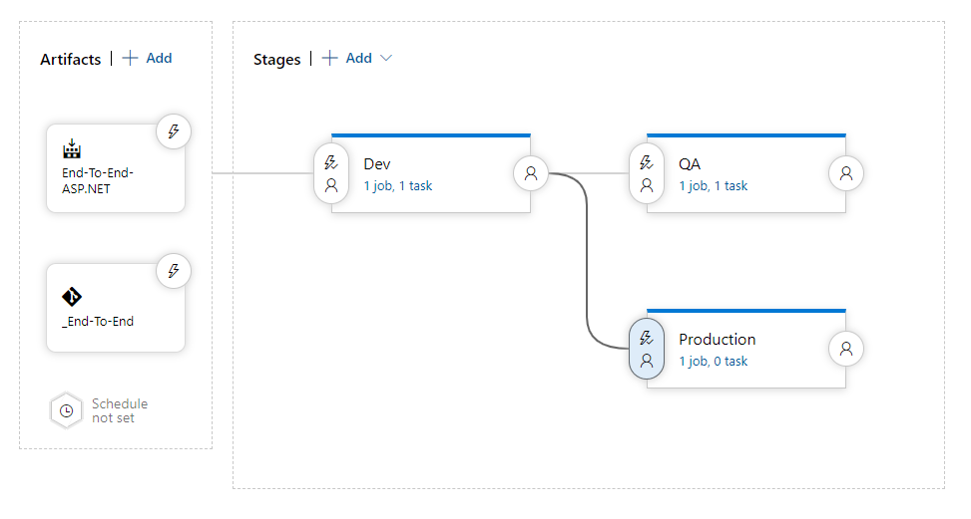
Releases in Azure Pipelines - Stages
Different components make up a release pipeline
Release pipeline takes artifacts and move it to different stages to reach the production at the end.

Slide 43
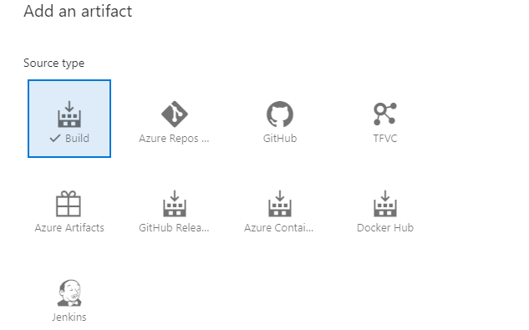
Releases in Azure Pipelines (Artefacts sources)
An artifact is a deployable component of your application

Slide 44
Releases in Azure Pipelines - Considerations for choosing artifact source
Traceability
Primarily when you work in a regulated environment like a bank or an insurance company, auditors ask you to provide traceability to sources that you deployed to prove the integrity of the package.
Auditability
You need to know who changed that line of code and who triggered the build that produces the artifact that is being deployed.

Slide 45
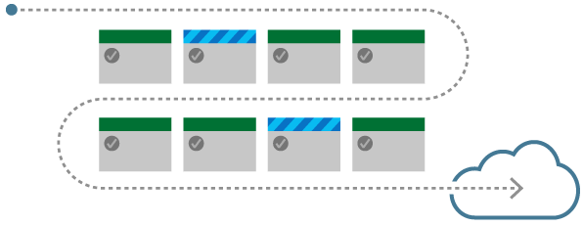
Releases in Azure Pipelines (Deployment stages)
Dev, QA, Prod
Multiple test stages to test the application
Customer adaption rings
Multiple geographic site for the same application
DB and Web tier of application
Staging slots for web sites

Slide 46
Releases in Azure Pipelines - Considerations for setting up Deployment stages
Is your stage long lived or short lived?
Who is going to use it?
Do you need a new stage for bug fix?
Can you afford downtime?
What is the purpose of this specific stage?
Is your target application overwriting an exiting one?
Do you need an isolated environment with encrypted data or discounted network?

Slide 47
Releases in Azure Pipelines – Deployment Triggers
Continuous Deployment Trigger
Manual Trigger
Schedule Trigger

Slide 48
Releases in Azure Pipelines – Considerations for release approval and quality gates
What we need to achieve from the approval? Is it compliance or security reasons?
When do you want to approve?
Who need to approve?
….any manual processes are a potential bottleneck. (Re)consider automating quality gates as automated checks as part of release pipeline
A quality gate is the best way to enforce a quality policy in your organization… however…

Slide 49
Releases in Azure Pipelines – Release Notes and Documentation
When you deploy a new release to a customer or install new software on your server, and you want to communicate what has been released to your customer, the usual way to do this is the use of release notes.
Storing technical documentation about your products, that is still in the design phase, is usually done on a team wiki
End user facing documentation are best hosted in document sharing portal, like SharePoint or Confluence.

Slide 50
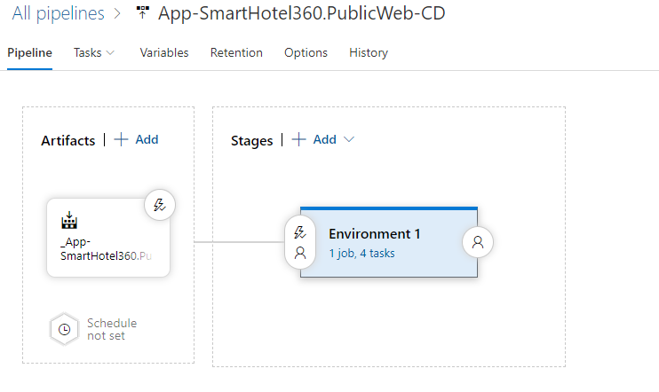
Releases in Azure Pipeline
Demo
Open SmartHotel360 in Azure DevOps
Open Pipelines --> Releases
View App-SmartHotel360.PublicWeb-CD
Artifacts, Triggers, Stages, Approvals
Tasks in stages

Slide 51
Run non-functional tests in Azure Pipelines - Demo
Demo to setup WhiteSource Bolt to view security alerts and compliance issues on open-source dependencies
WhiteSource Bolt: Find & Fix Open Source vulnerabilities (whitesourcesoftware.com)
WhiteSource Bolt - Visual Studio Marketplace
WhiteSource Bolt for Azure Pipelines - WhiteSource Documentation - WhiteSource documentation (atlassian.net)
Installing and activating the extension
Adding build task to Azure Pipeline
Viewing the report
Notes:
https://docs.microsoft.com/en-us/learn/modules/scan-open-source/
https://docs.microsoft.com/en-us/visualstudio/subscriptions/vs-whitesource

Slide 52
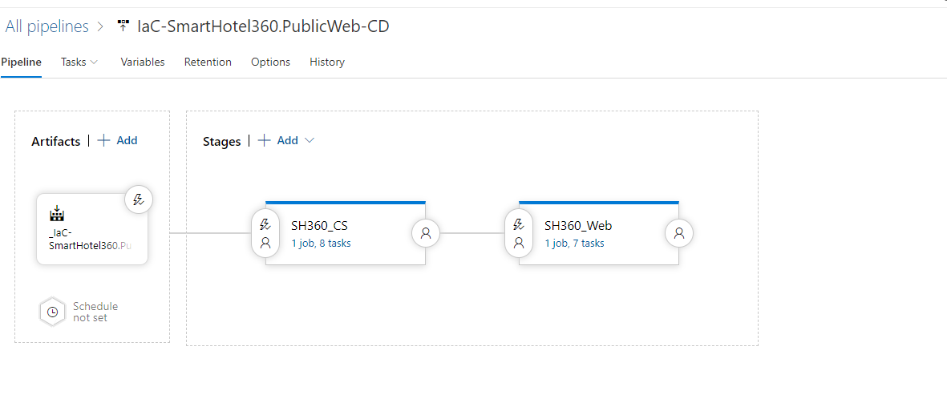
Build/Configure Infrastructure in Azure Pipeline
Infrastructure as Code at Avanade https://AVANADE.sumtotal.host/core/pillarRedirect?relyingParty=LM&url=app%2Fmanagement%2FLMS_ActDetails.aspx%3FActivityId%3D73034%26UserMode%3D0
Simple example – demo IaC pipeline in SmartHotel360
CI workflows can also be built as as GitHub Actions

